Slide 1
Question Paper Generation
With chat feature

Slide 2
ACKNOWLEDGEMENT
This project has been completed under the guidance of
Dr. Yugi Lee,
Raj Marri,
and TAs (SaiSri Narne, Gaikwad Priyanka)
CS5551 Advanced Software Engineering,
University of Missouri - Kansas City,
Spring 2020

Slide 3
OBJECTIVE & MOTIVATION
Question Paper Generation App is an application that helps to generate a question paper automatically from the data base.
This application can be used by academic institutions which comes with the Chat feature which is one of the main features amongst others.
This app is mainly developed in order to help out students and academic institutions to carry out their academic work like conducting and taking exams and evaluating tests without any difficulties with pre created database during pandemic effects.

Slide 4
SOFTWARE REQUIREMENTS
Heroku
Android studio
Babel edit
Mongo DB
Cordova
Node.js
Angular 8
Firebase account
Bootstrap 4
Socket programming

Slide 5
Features In App
Secure authentication
Authentication using social media
Alerts
Notifications
Chat section
Automatic question paper generation
Language change up to 8 major languages

Slide 6
Features In App
Responsive UI for web and mobile app
User friendly UI
Native mobile app
Publicly hosted web app
Student performance statistics using ng charts
User search using age and name
Left to right and vice versa altering of app.

Slide 7
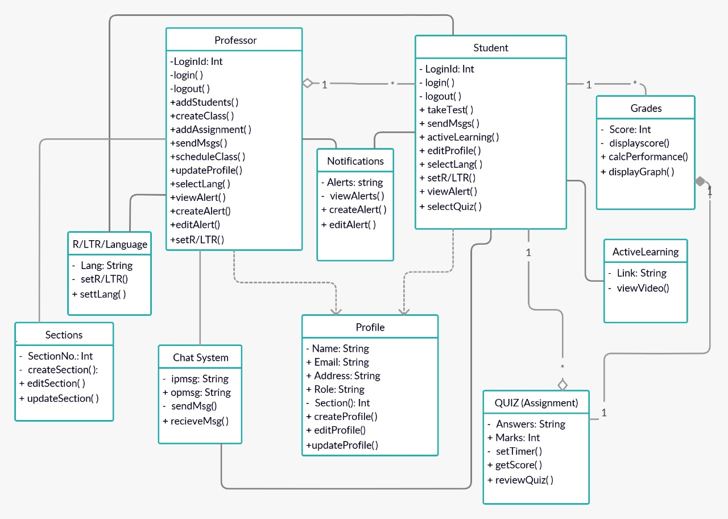
CLASS DIAGRAM

Slide 8
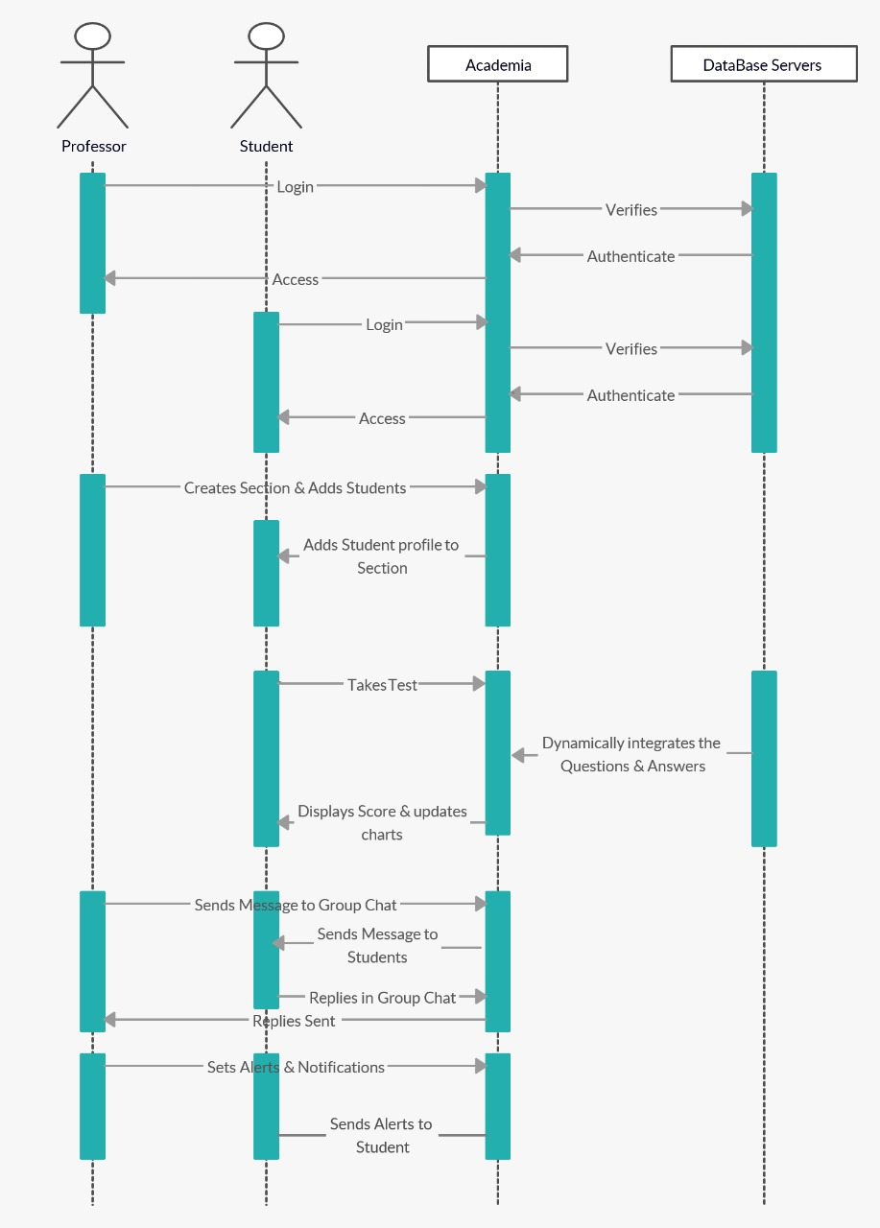
SEQUENCE
DIAGRAM

Slide 9
DEPLOYMENT
Both Web app and Mobile app with same core base have been created.
Two main API’s are created in the project :
- API for chat server
- Question Paper Generation
The API’s created are dynamic in nature with subject name and number of questions as input.
The Web App is deployed in Heroku and the mobile app is developed using apache Cordova 8.0

Slide 10
FUTURE SCOPE
This application can be further developed into a strict exam based platform by introducing face tracking system and also voice tracking system which can be integrated into official websites of institutions.
We can develop this application by increasing number of languages that this app can be available in.
We also can integrate this into official websites of institutions to access it with more ease.

Slide 11
REFERENCES
https://cordova.apache.org/docs/en/latest/guide/cli/
https://docs.mongodb.com/guides/server/introduction/

Slide 12
THANK YOU
PRESENTATION BY TEAM 4

